Slide 1
COMP 4332 / RMBI 4310
Big Data Mining and Management
Advanced Data Mining for Risk Management and Business Intelligence (2025 Spring)
Tutorial 3: General Pipeline of Classification
TA: Qing ZONG (qzong@connect.ust.hk)

Slide 2
Content —— Classification pipeline
Tokenization and Feature Extraction
Classifier Model
Single Layer Perceptron
Multi Layer Perceptron
Overfitting and underfitting
Validation Set
Visualization

Slide 3
Classification
Movie Reviews:
I absolutely loved this movie!
What a disappointment! The plot was predictable.
Class1 (e.g., Positive)
Class2 (e.g., Negative)
Class3 (e.g., Other)

Slide 4
One-vs-all (one-vs-the-rest)
Class1
Class2
Class3

Slide 5
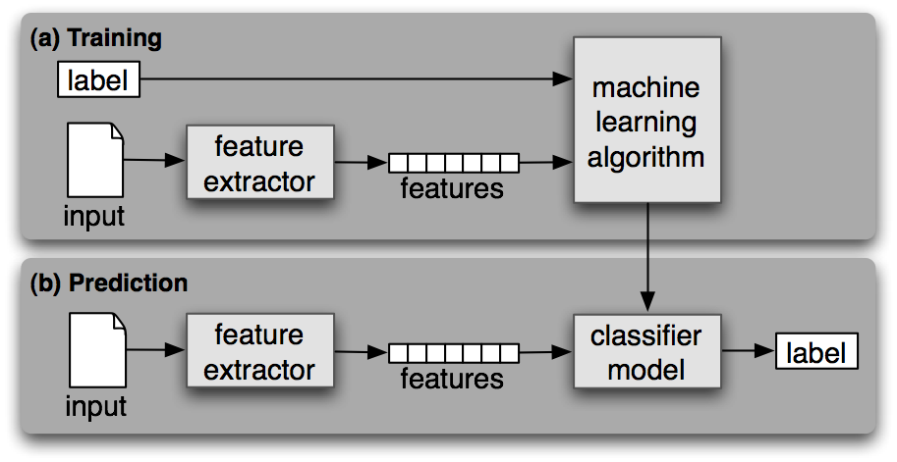
General Pipeline of Classification

Slide 6
Content —— Classification pipeline
Tokenization and Feature Extraction
Classifier Model
Single Layer Perceptron
Multi Layer Perceptron
Overfitting and underfitting
Validation Set
Visualization

Slide 7
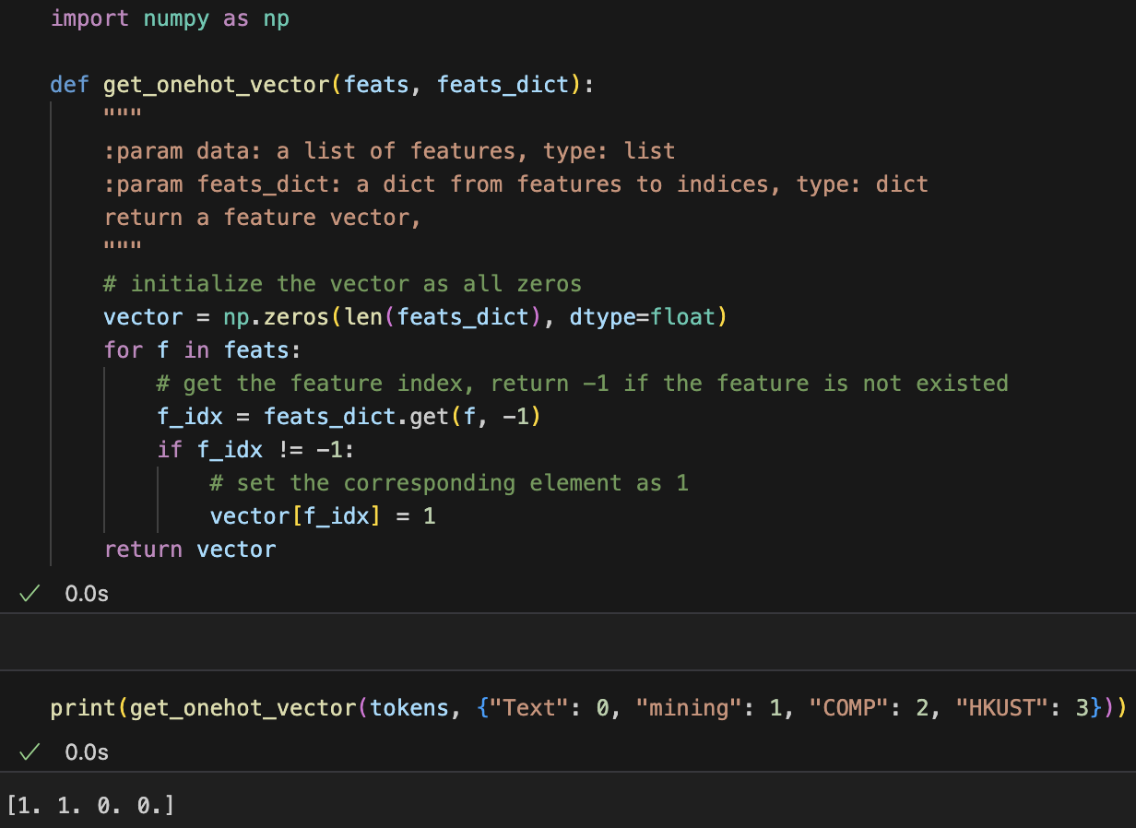
Tokenization and Feature Extraction
Example: ‘Text mining is to identify useful information.’
1. Tokenization: 'Text', 'mining', 'is', 'to', 'identify', 'useful', 'information', '.'
2. Feature Extraction: Converting them into one-hot or multi-hot vectors.

Slide 8
Content —— Classification pipeline
Tokenization and Feature Extraction
Classifier Model
Single Layer Perceptron
Multi Layer Perceptron
Overfitting and underfitting
Validation Set
Visualization

Slide 9
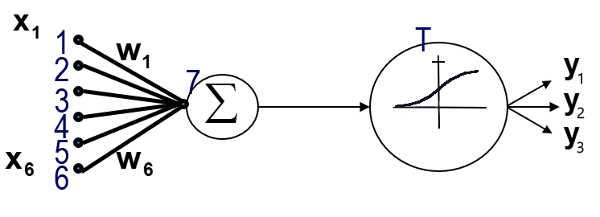
Single Layer Perceptron
One-vs-all single layer Perceptron.
Classification Rule: $y=softmax\left(w^{T}x+b\right)$, where $softmax{\left(t\right)}_{i}=\frac{e^{t_{i}}}{\sum_{j=1}^{K}{e^{t_{j}}}}$

Slide 10
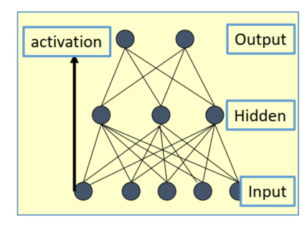
Multi Layer Perceptron
Classification Rule: $y={σ_{L}(…σ_{2}(H_{2}(σ_{1}(H}_{1}(x)))))$ , where $H_{i}$ is a layer and $σ_{l}$ is an activation.
Playground: https://playground.tensorflow.org/

Slide 11
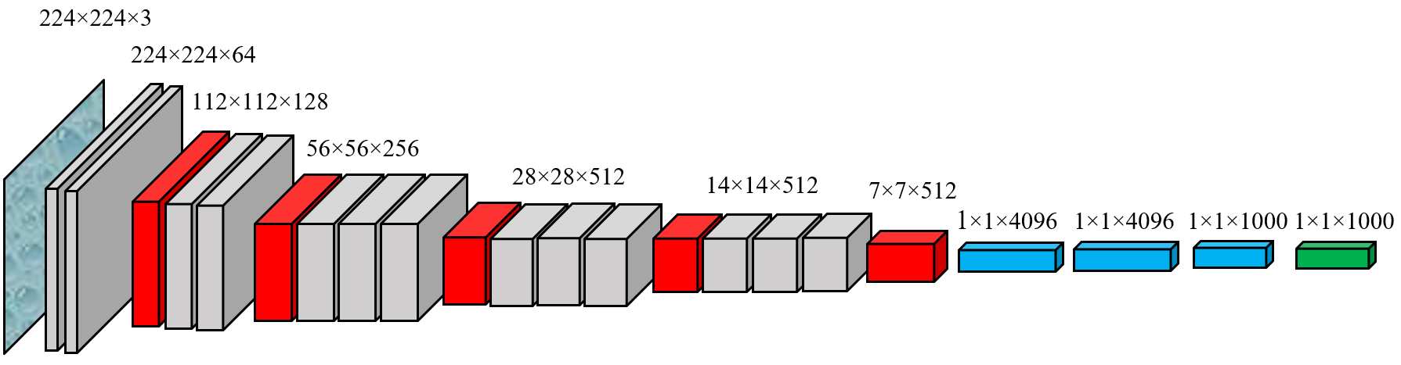
Single layer vs. multi layers
Linear separable data vs. complex data
Limited parameters vs. numerous parameters
Simple classification vs. wider uses
Image by Nshafiei - Own work, CC BY-SA 4.0, https://en.wikipedia.org/w/index.php?curid=60572704

Slide 12
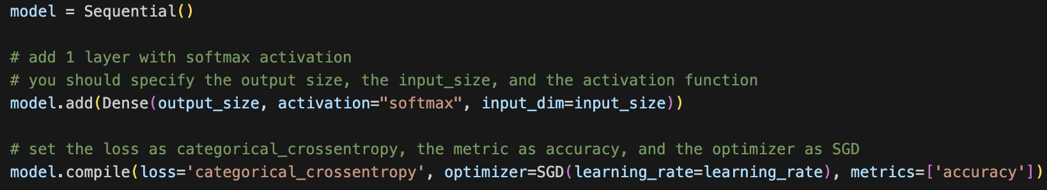
Classifier Model
We use Keras deep learning framework and use tensorflow as the backend.
keras.models.Sequential is a linear stack of neural network layers. And we can add different types of neural network layers, such as keras.layers.Dense.
We want to build a perceptron, which includes 1 dense layer with softmax.
Structure of MLP can be seen in ipynb

Slide 13
Other Details in the Implementation
NLTK is a leading platform for building Python programs to work with human language data.
NumPy is the fundamental package for scientific computing with Python.
pandas is an open source, BSD-licensed library providing high-performance, easy-to-use data structures and data analysis tools for the Python programming language.

Slide 14
Other Details in the Implementation
We use the tokenize(text) function to get the tokens of a document.
We use the get_onehot_vector(feats, feats_dict) function to get a $|V|$-dimension one-hot vector, where $\left|V\right|$ is the feature size (i.e., len(feats_dict)).
np.vstack is a function to concatenate $N$ number of $|V|$-dimension vectors to a $N×\left|V\right|$ matrix.
“v” of “vstack” comes from vertical. There is also np.hstack, which is horizontal stack.

Slide 15
Other Details in the Implementation
We choose the categorical crossentropy as the loss function and evaluate the model using the accuracy metric.
One epoch means the entire data are passed through the neural network only once.
The batch size corresponds to the number of examples sending to the neural networks at a time.

Slide 16
Content —— Classification pipeline
Tokenization and Feature Extraction
Classifier Model
Single Layer Perceptron
Multi Layer Perceptron
Overfitting and underfitting
Validation Set
Visualization

Slide 17
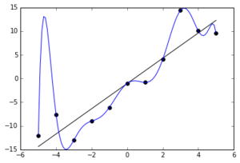
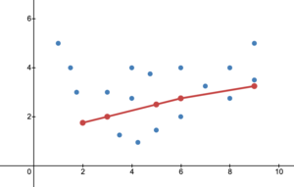
Overfitting & Underfitting
The blue line represents the over-fitted model.
The red line represents the under-fitted model
The diagrams are from https://en.wikipedia.org/wiki/Overfitting. You can check the website for more details.

Slide 18
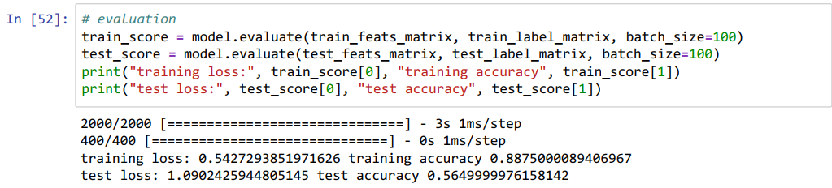
Overfitting
The training performance is much better than testing performance.

Slide 19
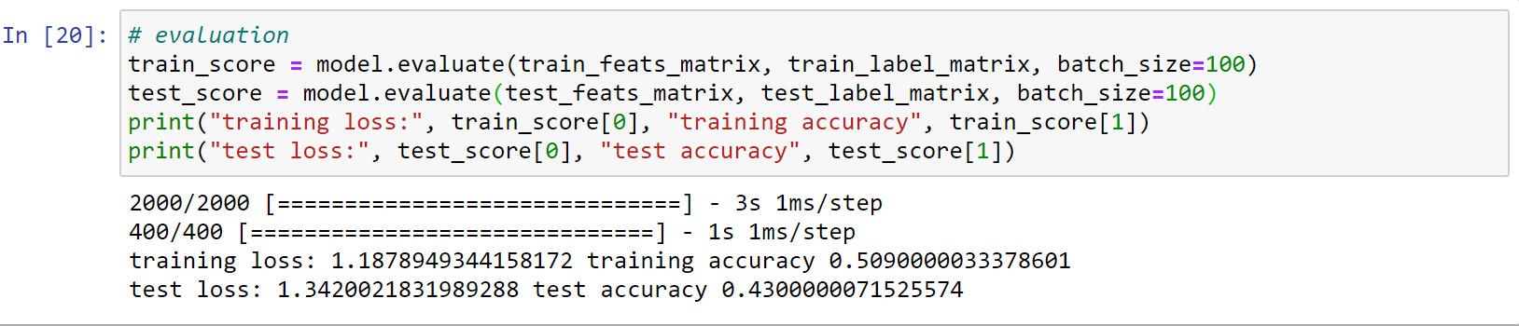
Underfitting
Neither training nor testing performance is good.

Slide 20
Validation Set
When we do not know the test performance, it is not easy to check when the classifier is good enough. Hence, we set the epochs manually (e.g. total_epoch = 10).
If we have a validation set, we can use the validation performance to find the best classifier during the training.

Slide 21
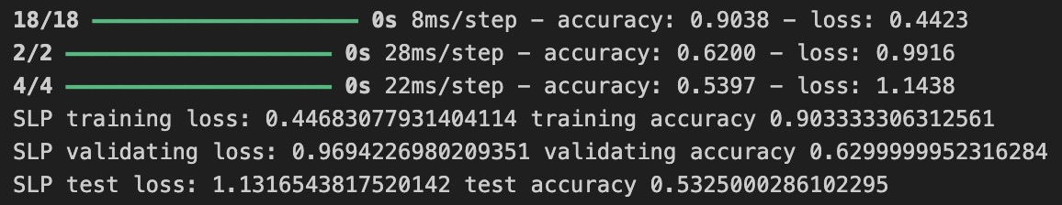
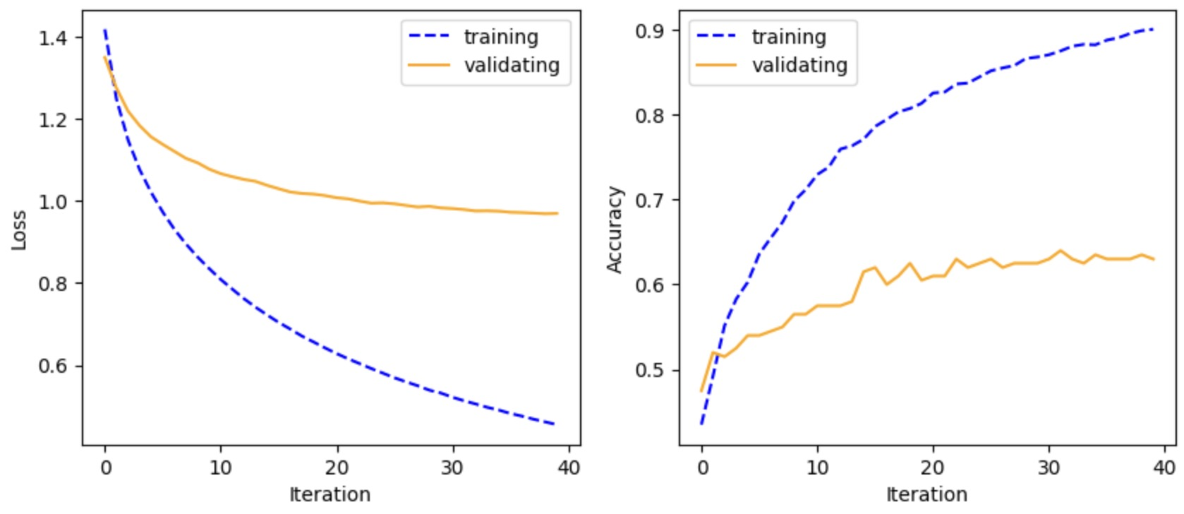
Visualization
Single Layer Perceptron

Slide 22
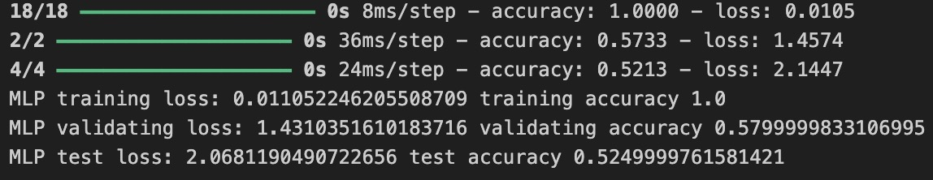
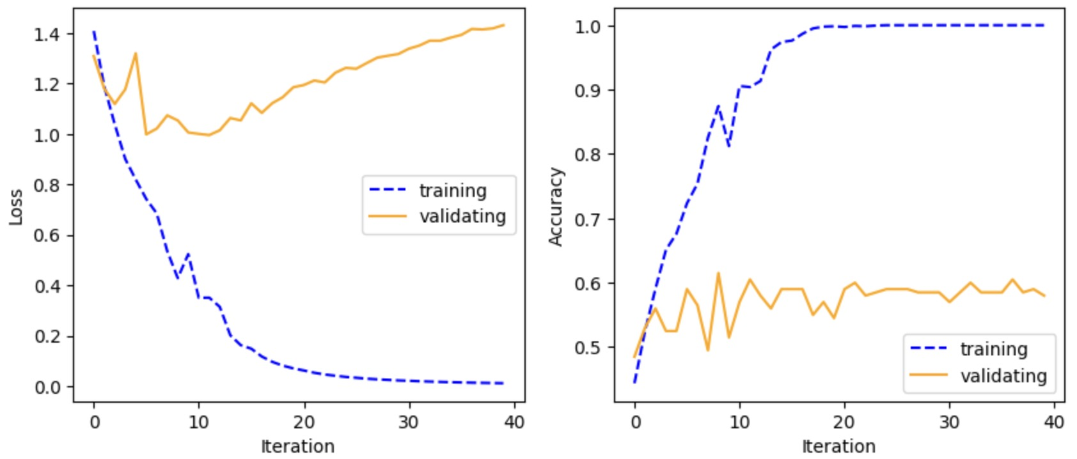
Visualization
Multi Layer Perceptron

Slide 23
Environment Reminder
$ conda create --name COMP4332 python=3.9
$ conda activate COMP4332
$ pip install jupyter

Slide 24
Thank You

